Slide 1
Workplace Based Assessments in UME
Rotation Orientation for Implementation, Fall 2023

Slide 2
Workplace Based Assessments
The AFMC has determined 12 Entrustable Professional Activities (EPAs) or clinical skills expected of a graduating medical student in the workplace, independent of specialty
The EPAs comprise one component of workplace based assessments
Our commitment: to provide frequent coaching in these 12 areas, and to reflect with you on your progress over clerkship
EPAs are credit/no credit and are NOT otherwise used to determine student progress in the program or to determine eligibility for graduation

Slide 3
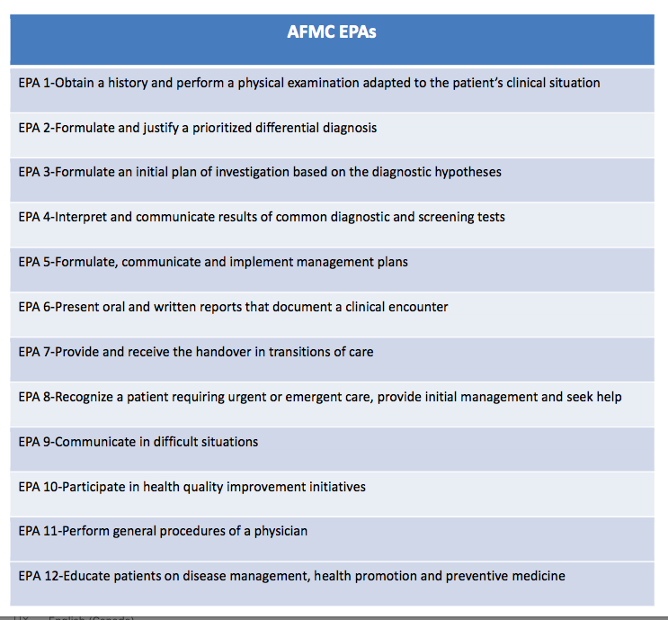

Slide 4
Example- EPA 1: Obtain a history and physical examination adapted to the patient’s clinical situation
Conduct a patient-centred interview, gathering all relevant biomedical and psychosocial information
Communicate using a patient-centred approach that facilitates patient trust and autonomy and is characterized by respect and compassion
Use clear and concise language; avoid or adequately explain medical jargon
Seek and synthesize relevant information from other sources, including the patient's family, with the patient's consent
Optimize the physical environment for patient comfort, dignity, privacy, engagement, and safety
Performs and demonstrates physical exam skills tailored to the clinical case

Slide 5
EPA 8: Recognize a patient requiring urgent or emergent care, provide initial management and seek help
Utilizes early warning signs, or rapid response team criteria, to recognize patients at risk of deterioration and mobilizes appropriate resources urgently
Asks for help when uncertain or requiring assistance; involves team members needed for immediate response and continued follow-up
Initiates and participates in a code response; performs basic life support when required including CPR during cardiac arrest
Rapidly assesses and initiates management to stabilize the patient
Clarifies patient's goals of care upon recognition of deterioration
Updates family members/caregiver/advocate to explain patient's status and escalation-of-care plans

Slide 6
How Will it Work?
Communication is key
Assessor: What are your learning goals for today?
Student: I have been working on prioritizing my differential diagnoses. I am hoping to have your feedback during clinic and to complete an EPA (EPA2).”
Coaching conversation after the observation
Documentation of the conversation using the EPA tool
Students should complete the contextual information on Elentra for faculty or resident/fellow assessors and either hand over their device (preferred) or have Elentra email the assessor with a link
*Expect some variation between courses but EPAs stay the same

Slide 7
EPA Assessment Scale
Benchmarking- ‘at the level of a
graduating medical student’
The entire scale will be used as students move through clerkship.

Slide 8
Narrative Feedback

Slide 9
Exemplars
STRENGTHS
ACTION PLAN FOR IMPROVEMENT

Slide 10
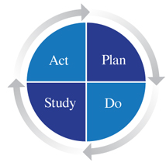
Requirements (credit/no credit):
1 EPA per week on average (minimum)
Aim for at least one EPA1 in each course (except Anaesthesia)
For 8-week courses, need 8 EPAs completed
For 6-week courses, need 6 EPAs completed
For 4-week courses, need 4 EPAs completed
Etc.
Residents/fellows may complete 50%
Please give us feedback- we’ll ask!

Slide 11
What happens if EPAs are not completed?
Credit/no credit required course component
Reminders will be sent by Elentra and Course Administrators
Students not meeting the required number of EPAs on course will
Meet with the Course Director
Meet with the EPA Implementation Lead
May be addressed in professionalism assessment
Will be required to return to course for completion

Slide 12
How do WBAs benefit students?
Opportunity for:
Further direct observation and feedback to improve performance in the clinical environment (assessment FOR learning, not OF learning)
Longitudinal feedback allows for reflection on progress within and across clerkship courses
Preparation for EPAs in residency

Slide 13
How will the data be used?
The most important component is the coaching conversation around the EPA immediately after the observation for your learning
Completion data will be tracked by administrators for credit/co credit
Narrative feedback from EPAs may inform the final clinical assessment (personalized feedback under ‘strengths’ is most helpful on MSPR)
The data will be included in the Learner Chart for reflection at Progress Meetings with Scholars

Slide 14
A shared journey…
Link to Student and Faculty Development Website for more info- newsletters, guides, and a tell-all 10min how-to video:
https://meded.temertymedicine.utoronto.ca/assessing-entrustable-professional-activities-epa-clerkship

