Slide 1


Workplace Based Assessment (WBA) in Clerkship
Overview Slide Deck
Fall, 2024
MD.OAE@UTORONTO.CA
Temerty Faculty of Medicine, University of Toronto

Slide 2
Workplace Based Assessments in UME
The AFMC has determined 12 Entrustable Professional Activities (EPAs) or clinical skills expected of a graduating medical student in the workplace, independent of specialty
The EPAs comprise one component of workplace based assessments
Our commitment: to provide frequent coaching in these 12 areas, and to promote reflection on progress over clerkship
EPAs are credit/no credit and are NOT otherwise used to determine student progress in the program or to determine eligibility for graduation

Slide 3
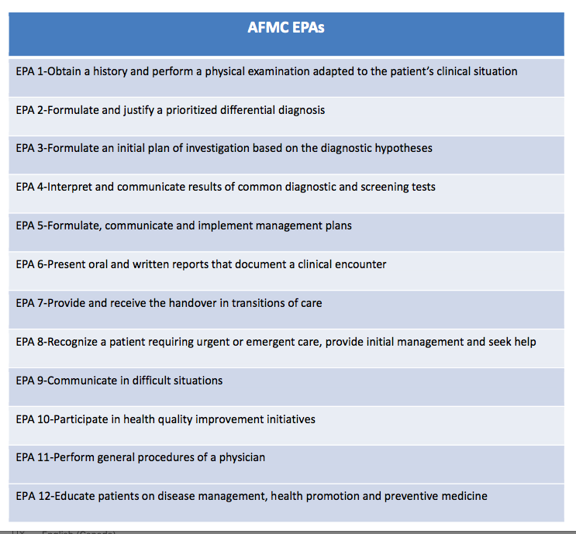

Slide 4
Key Observable Behaviours
Assessors will be presented with “Key Observable Behaviors” for each EPA to use as a reference to guide assessment and coaching
  No milestones for UME…
  No phases of training…
  No progress decisions…

Slide 5
EPA 1: Obtain a history and physical examination adapted to the patient’s clinical situation
Conduct a patient-centred interview, gathering all relevant biomedical and psychosocial information
Communicate using a patient-centred approach that facilitates patient trust and autonomy and is characterized by respect and compassion
Use clear and concise language; avoid or adequately explain medical jargon
Seek and synthesize relevant information from other sources, including the patient's family, with the patient's consent
Optimize the physical environment for patient comfort, dignity, privacy, engagement, and safety
Performs and demonstrates physical exam skills tailored to the clinical case

Slide 6
EPA 8: Recognize a patient requiring urgent or emergent care, provide initial management and seek help
Utilizes early warning signs, or rapid response team criteria, to recognize patients at risk of deterioration and mobilizes appropriate resources urgently
Asks for help when uncertain or requiring assistance; involves team members needed for immediate response and continued follow-up
Initiates and participates in a code response; performs basic life support when required including CPR during cardiac arrest
Rapidly assesses and initiates management to stabilize the patient
Clarifies patient's goals of care upon recognition of deterioration
Updates family members/caregiver/advocate to explain patient's status and escalation-of-care plans

Slide 7
How Does it Work?
Communication is key, example:
      Assessor: What are your learning goals for today? What would like me to observe?
      Student: I have been working on prioritizing my differential diagnoses. I am hoping to have your feedback during clinic and to complete an EPA (EPA2).”
Coaching conversation after the observation
Documentation using EPA tool in Elentra
Students have been asked to complete the contextual information on Elentra for faculty or resident/fellow assessors and either hand over their device (preferred) or have Elentra email the assessor with a link

Slide 8
Nuts and Bolts
Clerks ’start’ the EPA in Elentra and complete the contextual information
They hand over their device real time for completion or have Elentra send an email for completion at a later time
Make sure you toggle your role to MD Program in Elentra if needed
Demo: the following slides show the tool in Elentra- the one click and the narrative boxes are the entirety of the tool (plus the contextual info that precedes it)

Slide 9

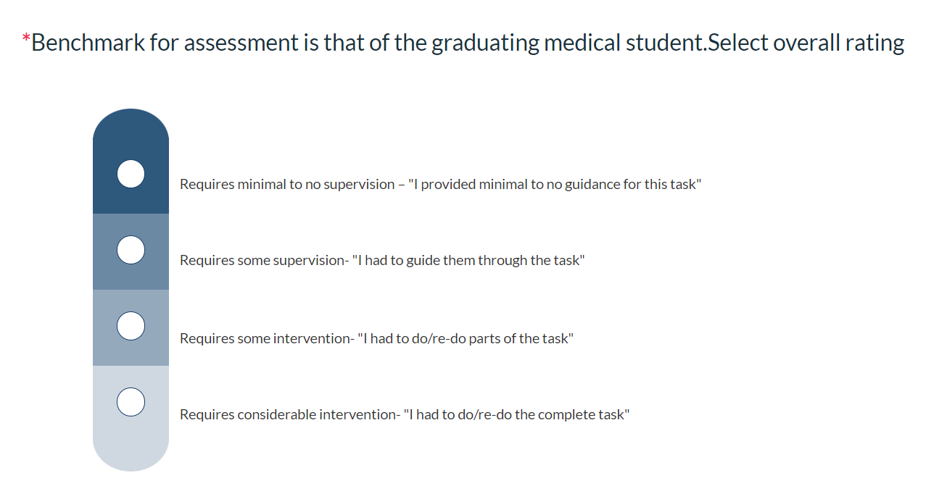
EPA Assessment Scale
Benchmarking- ‘at the level of a graduating medical student’
The entire scale will be used as students move through clerkship.

Slide 10
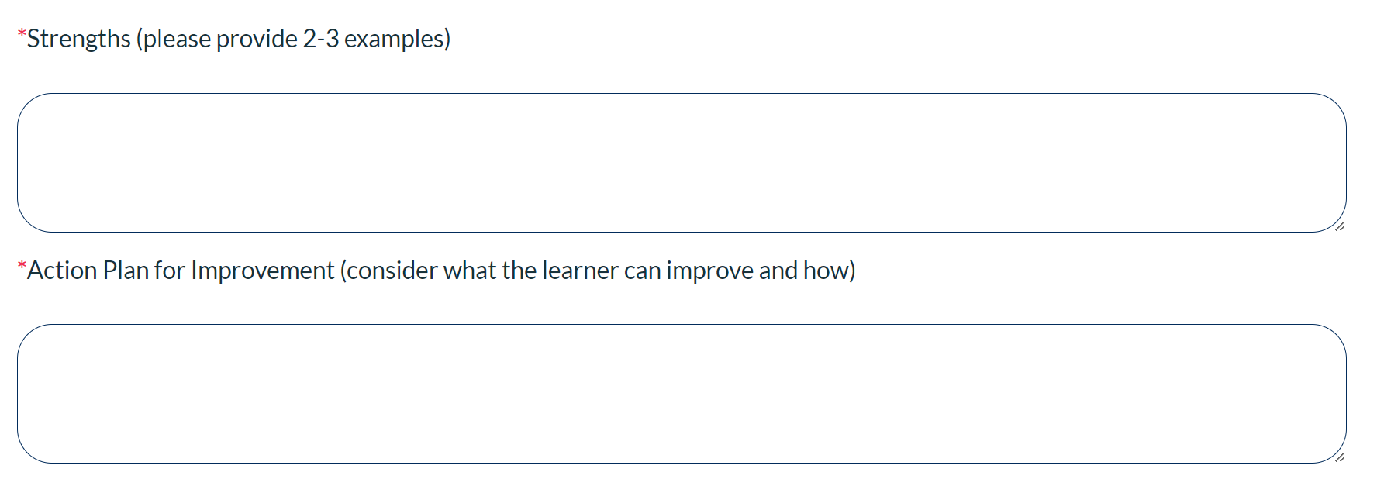
Narrative Feedback
The narrative section captures the verbal feedback provided.
This is the most important part of the EPA.

Slide 11
Exemplars
Feedback | Narrative | Why is this good?
Strengths (EPA 2*) | - comprehensive hx for back pain, particularly seeking out RFs for osteoporosis/compression fractures - utilized CORE Back Tool - clearly stated why malignancy/infection/ inflammatory ds ruled out | - SPECIFIC to encounter - SPECIFIC to EPA - reinforces aspects of performance to continue in future encounters
Action Plan (EPA 11**) | - (Suturing) - Needle 90 degrees to tissue - Proper bites to ensure strong closure - Smaller bites in corners and where closure more challenging -Try palming the needle driver for more control | - SPECIFIC to encounter - SPECIFIC to EPA - clearly outlines aspects of performance to work on in future encounters
*EPA 2- Formulate and justify a prioritizied differential diagnosis
**EPA 11- Perform general procedures of a physician

Slide 12
Assessor’s Role- Feedback and Coaching
  Encourage students to take advantage of all learning opportunities
  You already provide coaching as a regular part of your interactions with students
  The EPA tool is a means of documenting the coaching conversation
  EPAs are assessments FOR learning, not OF learning (growth mindset)

Slide 13
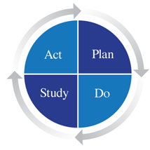
Student Requirements
EPA completion is a credit/no credit requirement for students
Students are required to complete the equivalent of 1 EPA per week (minimum) during their core rotations
Residents/fellows may complete up to 50% of EPAs for students
We continue to learn about the EPA process in UME
Please give us your feedback- we will ask!

Slide 14
What happens if EPAs are not completed?
Credit/no credit required course component
Reminders will be sent by Elentra and Course Administrators
Students not meeting the required number of EPAs on course will
      Meet with the Course Director
      Meet with the EPA Implementation Lead
      May be addressed in professionalism assessment
      Will be required to return to course for completion

Slide 15

How will the data be used?
The most important component is the coaching conversation around the EPA immediately after the observation
The data will be tracked by administrators for completion and noted ‘strengths’ on narrative feedback may be used to inform the final clinical assessment (course dependent)
The data will be included in the Learner Chart for reflection at Progress Meetings with Scholars

Slide 16

Questions?
md.oae@utoronto.ca
angela.punnett@sickkids.ca
https://meded.temertymedicine.utoronto.ca/assessing-entrustable-professional-activities-epa-clerkship

