Slide 1
Moving Beyond the Essentials for Teaching CBL
Robert Goldberg MD MScCH FRCPC
Susanna Talarico BEd MD FRCPC MScCH

Slide 2
Disclosures
None
There might be technical difficulties

Slide 3
Setting the Stage
It is critical to keep in mind that we are all learning and may say the wrong thing
If you use or hear a term that feels inappropriate, acknowledge it, and welcome and offer feedback in a non-defensive manner
Show kindness, respect, and compassion for our patients, teachers, students and ourselves as we respond to a mistake, both in professional and personal practice
We welcome your feedback!

Slide 4
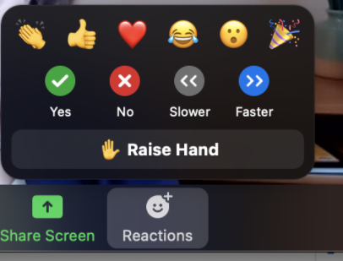
Zoom Features that Encourage Interactivity
Mute your mic, but get ready to jump in
Press space bar to unmute temporarily
Use the Chat Box
Raise your hand
Offer reactions

Slide 5
Objectives
By the end of the session you will be able to:
Describe and reflect on your experience as a CBL tutor
Share strategies, successes and challenges around facilitating CBL
Add to your repertoire of teaching techniques to facilitate learning and discussion in CBL
Discuss next steps for yourself as a CBL tutor

Slide 6
Outline
Introduction and Icebreakers
Strategies to Guide Your CBL
Case review: 5 Pitfalls that can Disrupt your CBL Environment
Sharing Strategies, Successes, and Challenges

Slide 7
Introductions: What do you do for Icebreakers?
Artwork by Katerina Mertikas

Slide 8
Raise Your Virtual Hand
Have you facilitated a CBL session?
No, this is my first time
Yes, for the last 1-3 years
Yes, for the last 3-5 years
Yes, for over 5 years

Slide 9
Raise Your Virtual Hand
Have you participated in a CBL faculty development session?
No, this is my first time
Yes, I attended part 1 of this series
No, but I watched the recording of part 1

Slide 10
Let’s Chat or Use the Chat!
What are you hoping to get out of this session?

Slide 11
Evaluations

Slide 12
Outline
Introduction and Icebreakers
Strategies to Guide Your CBL
Case review: 5 Pitfalls that can Disrupt your CBL Environment
Sharing Strategies, Successes, and Challenges

Slide 13
Encourage Active Learning and Productive Struggle
Engage students in guided discovery and ask probing questions that encourage problem solving and understanding, instead of providing direct instruction
Maximize learning in the longer term versus of performance in the shorter term
https://meded.temertymedicine.utoronto.ca/sites/default/files/assets/resource/document/18_Guided_%20Learning_in_CBL_Revised14Aug18.pdf
Kapur (2014) Examining Productive Failure, Productive Success, Unproductive Failure, and Unproductive Success in Learning, Educ Psychologist

Slide 14
Promote Cognitive Integration
Cognitive Integration involves looking at basic and clinical sciences in an integrated and causal way
Encourage students to make connections to the patient case, and guide them in understanding how basic science applies to clinical situations
For practical strategies on how to promote it, see:
https://meded.temertymedicine.utoronto.ca/sites/default/files/assets/resource/document/18_CBL_%20Cognitive_Integration_%20Questions.pdf

Slide 15
Use Contextual Variation
Learners are exposed to the same concept in different contexts
Ask, “what if…
For practical strategies on how to use meaningful contextual variation, see:
https://meded.temertymedicine.utoronto.ca/sites/default/files/assets/resource/document/18_Adventures_in_Teaching_Contextual_Variation.pdf

Slide 16
Learner Environment
We must create psychologically safe environments
A psychologically safe environment is one where learners feel comfortable asking questions, taking risks, making mistakes, and asking for help. They feel respected, and that their efforts and skills are valued (Edmonson, 1999).
A supportive and safe environment MUST be created to allow students to feel comfortable participating. Encourage critical thinking while validating student responses, gently correcting misconceptions, and avoiding shaming.

Slide 17
Optimal Relationship between Psychological Safety and Performance Standard
Environment | Low performance standard | High performance standard
High psychological safety | Comfort zone | Learning high performance zone
Low psychological safety | Apathy zone | Anxiety zone
Edmondson, Amy (2019) The fearless organization. John Wiley and Sons Inc. Hobohen, New Jersey.

Slide 18
Optimal Relationship between Psychological Safety and Performance Standard
Environment | Low performance standard | High performance standard
High psychological safety | Comfort zone | Learning high performance zone
Low psychological safety | Apathy zone | Anxiety zone
Edmondson, Amy (2019) The fearless organization. John Wiley and Sons Inc. Hobohen, New Jersey.

Slide 19
Destigmatizing Failure for Psychological Safety
Edmondson, Amy (2019) The fearless organization. John Wiley and Sons Inc. Hobohen, New Jersey.

Slide 20
The focus: The Learner Environment
‘Learning environment refers to the diverse physical locations, contexts, and cultures in which students learn…encompasses the culture of [classroom] —its presiding ethos and characteristics, including how individuals interact with and treat one another—as well as the ways in which teachers may organize an educational setting to facilitate learning…..’
The Glossary of Educational Reform, https://www.edglossary.org/learning-environment/

Slide 21
Create a safe space
Ensure the content, photos and the language used are diverse, inclusive, and appropriate
Refer to:
Queen’s University Style Guide: Equity, Diversity and Inclusion https://healthsci.queensu.ca/academics/edi/style-guide
CAMH Health Equity and Inclusion Framework for Education and Training https://www.eenet.ca/resource/health-equity-and-inclusion-framework-education-and-training
https://equity.ubc.ca/resources/equity-inclusion-glossary-of-terms/
Misrepresenting Race — The Role of Medical Schools in Propagating Physician Bias NEJM https://www.nejm.org/doi/full/10.1056/NEJMms2025768

Slide 22
Outline
Introduction and Icebreakers
Strategies to Guide Your CBL
Case review: Five Pitfalls that can Disrupt your CBL Environment
Sharing Strategies, Successes, and Challenges

Slide 23
Five Faculty Pitfalls that can Disrupt the Learning Environment
Lack of preparation and enthusiasm
Not setting the stage for open and respectful group discussion
Inappropriately responding to a partially correct or incorrect answer
Overlooking topics outside our scope of expertise
Failing to acknowledge uncomfortable situations

Slide 24
Case scenario: You are a CBL tutor…

Slide 25
Case Synopsis
This case explores type 2 diabetes and emphasizes the principles of chronic disease management.
The diagnosis and management of type 2 diabetes, with a particular focus on preventing the microvascular and macrovascular complications of the disease is important for students to learn.
The case also explores some of the unique issues and social determinants of health relevant to Indigenous Peoples.

Slide 26
Case Synopsis
The case does NOT address some of the unique issues in managing type 1 diabetes; rather, this content is covered in the pre-week learning, lectures, self-learning module on diabetic ketoacidosis (often the inciting event of type 1 diabetes) and via a patient roundtable discussion on type 1 diabetes.
Background: Students will have had a lecture on the pharmacology of the various drugs prescribed in the management of type 2 diabetes as well as on the microvascular and macrovascular complications of the disease prior to your Thursday CBL review session.

Slide 27
Scenario: Getting ready for CBL…
You have done CBL and other MD program small group teaching sessions many times in the past, but this is the first time you are facilitating this particular case…
It’s a busy week (clinically and personally) and you figure given your knowledge of diabetes, you will be able to navigate the contents of the case and the discussion on the go…

Slide 28
Pitfall #1: Lack of preparation and enthusiasm
We are all busy!
…but try not to “wing it”
Even 30 minutes of pre-case review can allow you to frame the questions within the weeks’ content
Students notice and appreciate your preparation!

Slide 29
What can you do to give your session the factor?
WOW!
Review the dialogue in the CBL case itself…
Share highlights with the students
Ask “why” is question X asked?
Incorporate content from the students’ lectures, pre-week and/or mid-week modules into your session
Review the students’ responses
Screen share!
Use a board
Whiteboard, jamboard, flipchart paper, etc.
Ask students to label questions as “curious, confident, or confused”

Slide 30
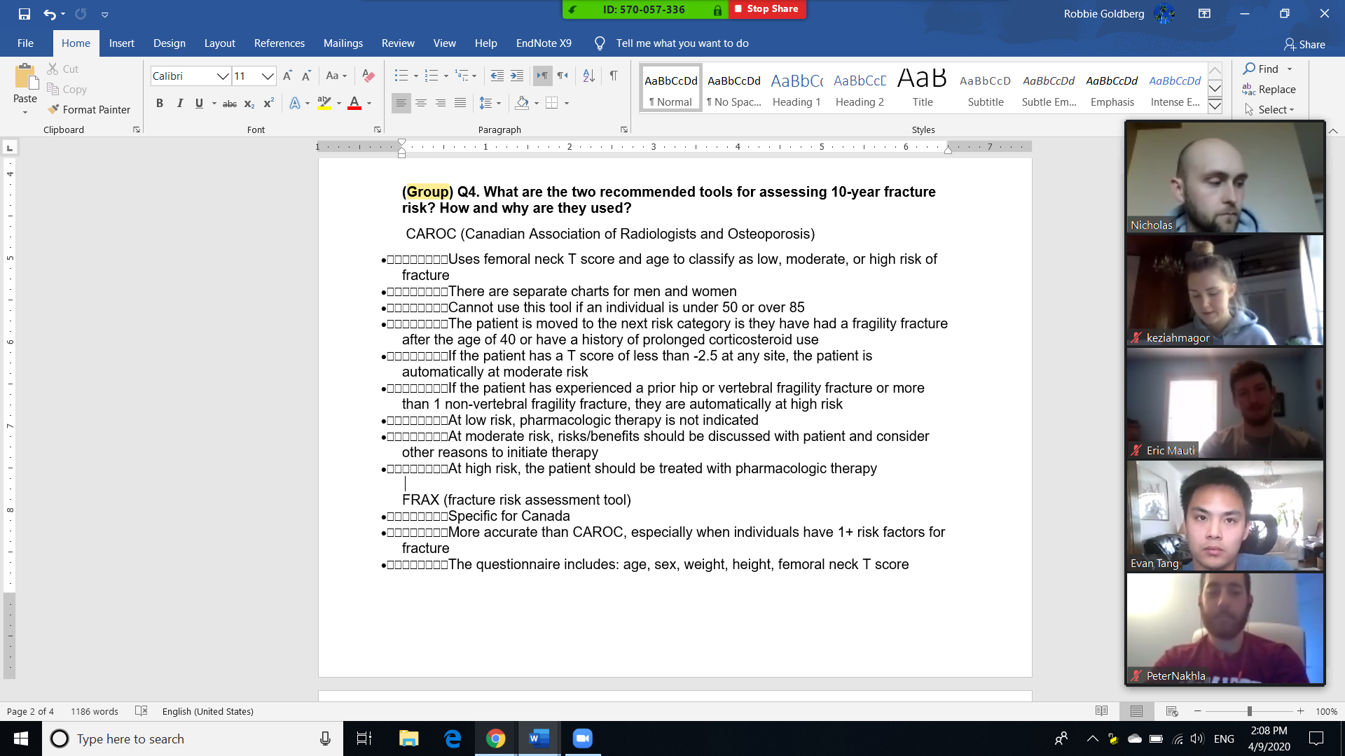

Slide 31
Back to the Scenario: Starting your session…
You introduce yourself, a background on your clinical (and personal) interests, and start with an icebreaker to build rapport
You jump right into the case…

Slide 32
Pitfall #2: Not setting the stage for open and respectful group discussion
It is important to create guidelines for discussion
Cultural humility
Personal devices and engagement
Learning pronouns
Framing Question Asking and Turn Taking

Slide 33
Setting the Stage – Acknowledging Ourselves as Learners
It is critical to keep in mind that we are all learning and may say the wrong thing
If you use or hear a term that feels inappropriate, acknowledge it, and welcome and offer feedback in a non-defensive manner
Show kindness, respect, and compassion for our patients, teachers, students and ourselves as we respond to a mistake, both in professional and personal practice
We welcome your feedback!
Language Matters (in development), MD Program Office of Faculty Development

Slide 34
Cultural Humility
Cultural Humility is “a process of self-reflection to understand personal and systemic biases and to develop and maintain respectful processes and relationships based on mutual trust. Cultural humility involves humbly acknowledging oneself as a learner when it comes to understanding another’s experience.”³
Division of Family Practice. Cultural Safety and Humility. Divisions of Family Practice, An FPSC Initiative. Published 2017. Accessed January 18, 2023.

Slide 35
How to Learn Someone’s Pronouns
When you first meet someone, consider introducing yourself with your pronouns: "Hi, I'm _____, and my pronouns are she/her."
By sharing your pronouns, you're allowing the other person to share theirs, but not forcing them to.
Also, avoid saying "preferred" pronouns as it implies that gender is a preference.
You may need to clarify with a student if the name introduced is not in your list for assessment and taking attendance. However, they should not have to justify why they use a different name
https://blog.hubspot.com/marketing/gender-neutral-pronouns

Slide 36
Personal Devices and Engagement
Students should be actively contributing to the group learning experience…
They should not be using computers or phones for activities unrelated to CBL
They should turn off notifications to minimize distractions
How will you be asking questions?

Slide 37
Framing Expectations around Questions During the Session
“My goal is to create a safe and supportive learning environment”
Turn taking: “I will be asking questions in the following manner”
The order of whom I see on my screen
Asking the group
Students nominate the next speaker
“My intention is never to put you on the spot and it is completely okay to have an incorrect answer”
Consider framing your own personal experiences!

Slide 38
Back to the Scenario: During your session…
You have a student summarize the case of the week…
You go through the answers from the week’s questions and make an effort to foster discussion, incorporate the faculty guide responses, and your own clinical anecdotes
You are disappointed when the students don’t seem to have a grasp of the material

Slide 39
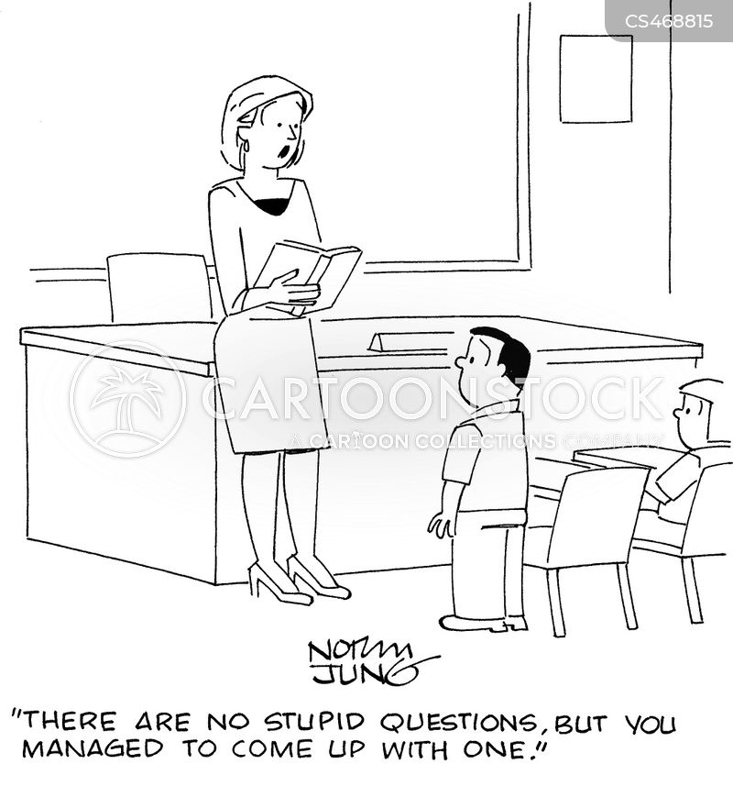
Pitfall #3: Inappropriately responding to a partially correct or incorrect answer

Slide 40
Strategies for Responding to Incorrect Answers
How can we respond to and engage learners, help create and maintain psychologically safe environments (where learners feel comfortable making mistakes, asking for help and taking risks)?
Consider your verbal and non-verbal cues…

Slide 41
Strategies for Responding to Incorrect Answers: Verbal
Verbal
Validate the student’s response (and the parts that were correct)
Normalize - thank the student for sharing the incorrect response (“I’m so glad you said this, that is so common”)
Encourage the student to think aloud (why, how) to see if they pick up the error, without shaming
Frame around yourself (“this is an area I struggled with”)
-Tips for Creating and Maintaining an Inclusive Small Group Synchronous Learning Environment, MD Program Office of Faculty Development

Slide 42
Strategies for Responding to Incorrect Answers: Non-verbal
Non-Verbal
Eye contact
Tone of voice (hesitation)
Facial expressions
Posture
-. Br J Gen Pract. 2010 Feb;60(571):83-7.
- Br J Gen Pract. 2010 Feb 1; 60(571): 76–78.

Slide 43
Back to the Scenario: Your response…
You encourage students to answer questions and make a deliberate effort to validate student responses, normalize partially or incorrect answers, and gently encourage students to think out loud.
You make a deliberate effort to be enthusiastic, and maintain a positive tone of voice even when disappointed with students’ preparation.
You find that participation has increased in the group and that there is a more collaborative discussion.
You continue to work through the CBL case questions…

Slide 44
Pitfall #4: Overlooking topics outside our (usual) scope of expertise
Many of us have a tendency to gravitate to the medical expert role…

Slide 45
Perusing the Questions in the CBL Case

Slide 46
Perusing the Questions in the CBL Case

Slide 47
What can you do to foster a fruitful discussion?
Don’t overlook non-medical expert questions…
Acknowledge your gaps in knowledge if present
Encourage your students to share their own experiences
Lean into discomfort when exploring topics that are more sensitive…
Feeling uncomfortable is not the same as feeling unsafe
Use the tutor guide!
Consider non-verbal cues!

Slide 48
Back to the Scenario…
You embark upon a discussion around providing care to First Nations patients and barriers to diabetes care as discussed in the tutor guide…
A student in the group asks a question that you worry could make individuals in the group feel uncomfortable….
“Hey guys, I have a question. Are there even that many Native people in Toronto?”
Has this ever happened to you?

Slide 49
Pitfall #5: Failing to acknowledge uncomfortable situations
What are you thinking/feeling?
How might you respond?

Slide 50
Language Matters: Overarching Principles
Self-identification is critical
Deciding whether or not something is offensive is the purview of the group to whom it is offensive
We will not always get it right and we can support each others’ learning journeys
The nature of language and its usage is to change
Critical reflexivity and humility are key

Slide 51
Responding in Unsafe Situations
Acknowledge that some language and behavior is not appropriate and clearly offensive
I.e. Racial slurs, any form of humiliation or harassment, etc.
Depending on the context, consider bringing people IN vs calling them OUT
“May I interject? We began by prioritizing safety, what was just said is offensive and threatens safety. Let’s stop and talk about why it’s offensive even if it wasn’t meant to be….”
“Time out. This is not acceptable. Let’s pause and talk about why…”
“Thank you for taking risks and speaking up, even if you’re unsure of how to say it”
“Thank you for making us pause and think”

Slide 52
Responding in Unsafe Situations
RESPOND with humility
“I recently learned that….” or “It was brought to my attention…”
AVOID judgmental, demeaning, or punitive language
I.e. You might say, “that’s offensive ” or “that is racist language” vs calling someone “racist”
We may make things worse if we come from a judgmental and critical lens – or we may create an impactful learning moment
We do not want to silence people or create a culture where people are afraid to speak. We want people to feel safe taking risks and making mistakes, while at the same time remaining open to learning and growing.

Slide 53
Language matters
The use of the term “Indian” or “Native” is generally not appropriate for a healthcare provider, but may be appropriate for the community to describe themselves
e.g. the Native Women’s Association of Canada uses the term Native, and many patients families might do the same
- Peer discussions with colleagues (cited with permission)

Slide 54
Language matters
Indigenous Peoples is commonly used as a collective term for all the original peoples of Canada and their descendants. There are three distinct and diverse groups of Indigenous Peoples in Canada: First Nations, Métis, and Inuit
“Indigenous people” with a lower case “people” refers to more than one Indigenous person rather than the collective group of Indigenous Peoples
The term “Indigenous” is increasingly replacing the term “Aboriginal”, as the former is recognized internationally, however, the term Aboriginal is still used and accepted
https://www.national.ca/en/perspectives/detail/no-perfect-answer-first-nations-aboriginal-indigenous/
Language Matters (in development), MD Program Office of Faculty Development

Slide 55
Back to the Scenario…
You consider that if you were not sure how to respond at the time, you might…
Debrief with colleagues
Reach out to your site lead or course director to connect you with resources and provide support
Follow-up with individuals in the group via email and/or direct discussions once you have spoken with colleagues and/or debriefed
Reflect

Slide 56
Outline
Introduction and Icebreakers
Strategies to Guide Your CBL
Case review: 5 Pitfalls that can Disrupt your CBL Environment
Sharing Strategies, Successes, and Challenges

Slide 57
Sharing Strategies, Successes, and Challenges
Let’s Chat or Use the Chat!
How’s it going?
What has been the greatest success?
How did you achieve that success?
What has been the greatest challenge?
Strategies for addressing that challenge?

Slide 58
OFD Resources
Adventures in Teaching!
Responding to an Incorrect Answer
Silence – Learners are Hesitant to Engage
Optimizing the virtual learning environment
https://meded.temertymedicine.utoronto.ca/sites/default/files/assets/resource/document/20_Adventures_in_Teaching_Virtual_Teaching.pdf
https://meded.temertymedicine.utoronto.ca/sites/default/files/assets/resource/document/20_Adventures_in_Teaching_Optimizing_Enviro_Revised09Sept20.pdf
https://meded.temertymedicine.utoronto.ca/sites/default/files/assets/resource/document/21_Inclusive_Virtual_Learning_Environment_Revised12Jan21.pdf

Slide 59
Other Resources
MD Program Office of Faculty Development
https://meded.temertymedicine.utoronto.ca/cbl-tutors
Centre for Faculty Development – offers a variety of workshops throughout the year
https://centreforfacdev.ca/upcoming/

Slide 60
Objectives
By the end of the session you will be able to:
Describe and reflect on your experience as a CBL tutor
Share strategies, successes and challenges around facilitating CBL
Add to your repertoire of teaching techniques to facilitate learning and discussion in CBL
Discuss next steps for yourself as a CBL tutor

Slide 61
Five Faculty Pitfalls that can Disrupt the Learning Environment
Lack of preparation and enthusiasm
Not setting the stage for open and respectful group discussion
Inappropriately responding to a partially correct or incorrect answer
Overlooking topics outside our scope of expertise
Failing to acknowledge uncomfortable situations

Slide 62
Questions?
…or e-mail us
susanna.talarico@sickkids.ca
robert.goldberg@utoronto.ca

Slide 63
Thank you!

